Slide 1
A novel model of TB progression using CompuCell3D
James Doran

Slide 2
Outline
Introduction
Model
Results
Discussion

Slide 3
Introduction
TB is caused by airborne Mycobacterium tuberculosis (Mtb) transmission
1.6 million died from TB in 2021
TB is treated with antibiotics (~6 months)
Bowness et al. (2018)
Distance to nearest blood vessel is important
Dormant bacteria tend to remain after treatment
CompuCell3D (CC3D) models biological cellular processes
I’m developing a within-host TB model using CC3D

Slide 4
Model
Conceptual model
CompuCell3D

Slide 5
Conceptual model
Cells:
Macrophages
T cells
Mtb bacteria
Blood vessels
Caseum
Chemical fields:
Oxygen
Chemokine
Macrophage activating cytokine

Slide 6
Macrophages

Slide 7
T cells
Either
Or

Slide 8
Mtb bacteria
Slow-growing extracellular
Fast-growing extracellular
Intracellular

Slide 9
Caseum
Notes:
Latin for “cheese”

Slide 10
Fields
Oxygen
Turns pandas into rabbits
Chemokine
HELP
Macrophage activating cytokine
Shia LaBeouf’s voice

Slide 11
Biological processes
Phagocytosis
Immune cell recruitment
Mtb bacteria state transition
Chemotaxis
Macrophage activation
Killing of (chronically) infected macrophages
Bursting of chronically infected macrophages
Replication

Slide 12
Phagocytosis

Slide 13
Immune cell recruitment
BLOOD VESSEL
Oxygen
Oxygen
Oxygen
Oxygen
Oxygen
Oxygen

Slide 14
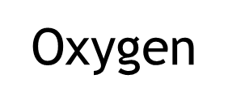
Mtb bacteria state transition

Slide 15
Chemotaxis

Slide 16
T cells activate resting macrophages
ZZZ

Slide 17
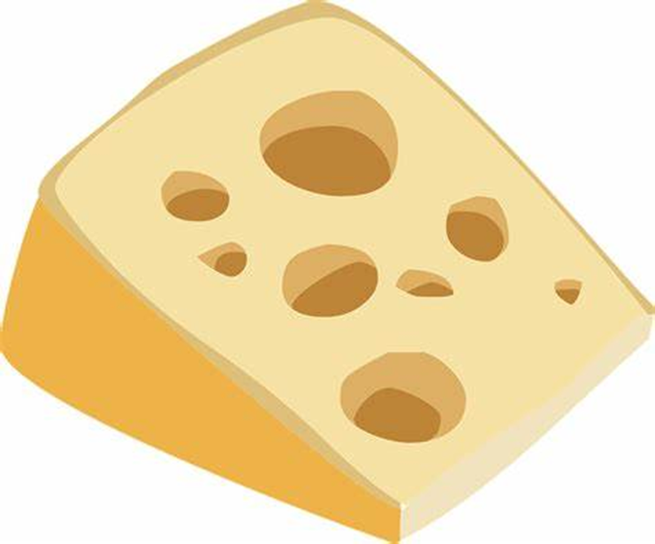
T cells kill (chronically) infected macrophages

Slide 18
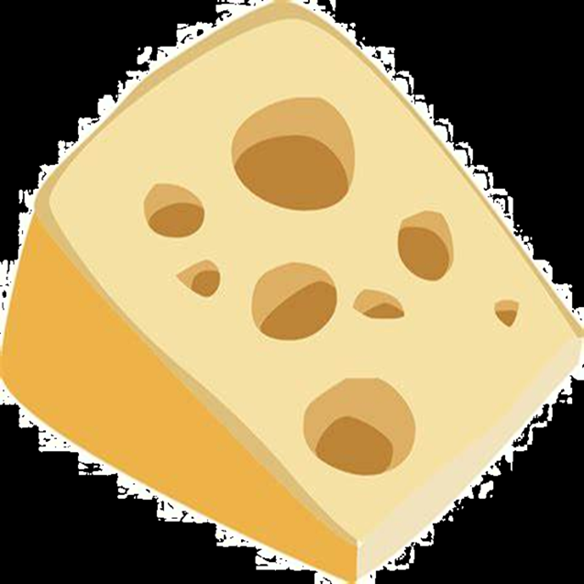
Chronically infected macrophages burst

Slide 19
Replication

Slide 20
Outcomes
Either:
(containment within a granuloma)
Or
(exponential growth of Mtb bacteria)

Slide 21
CompuCell3D
Mixture of XML script and Python
Cells:
live on a lattice
are assigned attributes
can interact with chemical fields

Slide 22
CompuCell3D
Proposed cell configurations are accepted/rejected as follows:
Choose a random lattice site
Choose a neighbouring site to copy to
Calculate the proposed change in energy (ΔH)
If ΔH ≤ 0, accept the new configuration
If ΔH > 0, accept with probability $e^{−\frac{ΔH}{T_{m}}}$
Notes:
Originally used to model spins on a lattice in order to study ferromagnets

Slide 23
CompuCell3D

Slide 24
Initial conditions
Slow-growing extracellular bacteria (6)
Fast-growing extracellular bacteria (6)
Resting macrophage (105)
Blood vessel (49)
Wall (1)

Slide 25
Results
TBC!
Expected results:
Containment in about 90% of simulations
Exponential growth in about 10% of simulations
Longer average distance to initial cluster
Predominantly slow-growing extracellular bacteria left

Slide 26
Discussion
Easy to understand
Can update states/parameters over time
Allows for stochasticity and complex dynamics
Open source, modular and easy to share
Not analytically tractable
Lots of parameters!
Need to average over many (slow) simulations

Slide 27
Future work
Finish parameterisation
Sensitivity and uncertainty analysis
Test all model components in full
Run 100 simulations and compare to original model
Incorporate into a multi-scale TB model

Slide 28
Summary
First within-host TB model made using CC3D
Cellular Potts approach plus cell-field interactions
Results should validate Bowness et al. (2018)

Slide 29
Acknowledgements
My supervisors (Ruth and Kit)
2022 CompuCell3D workshop instructors
My Hackathon teammates
Aminat and Chris

Slide 30
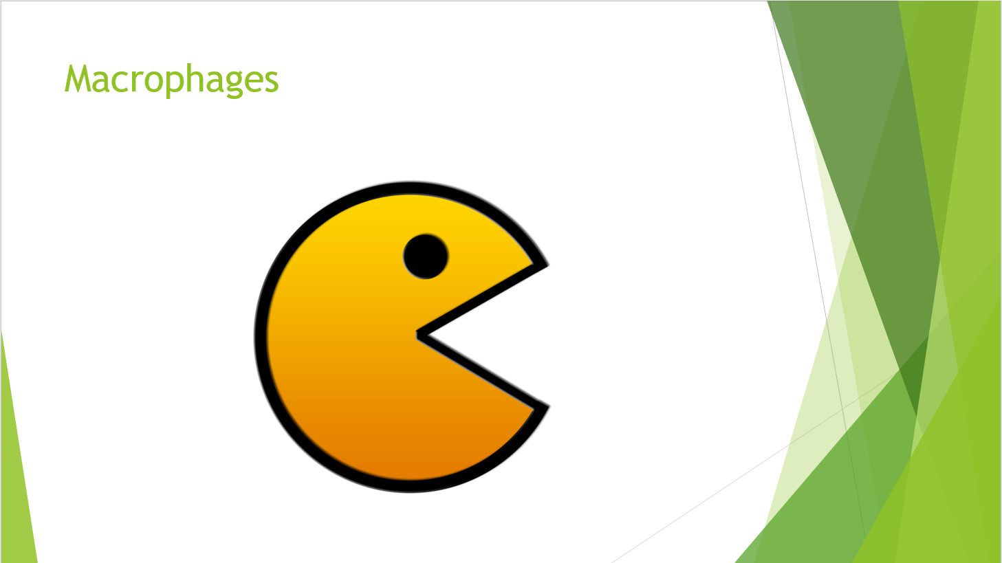
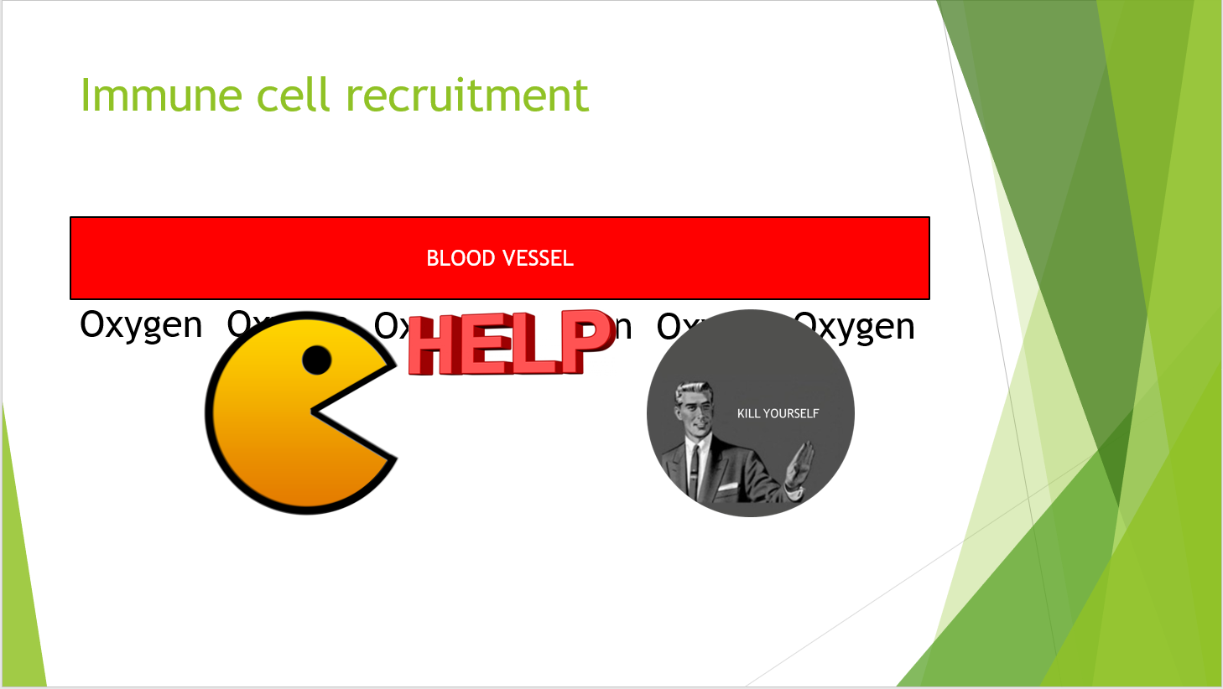
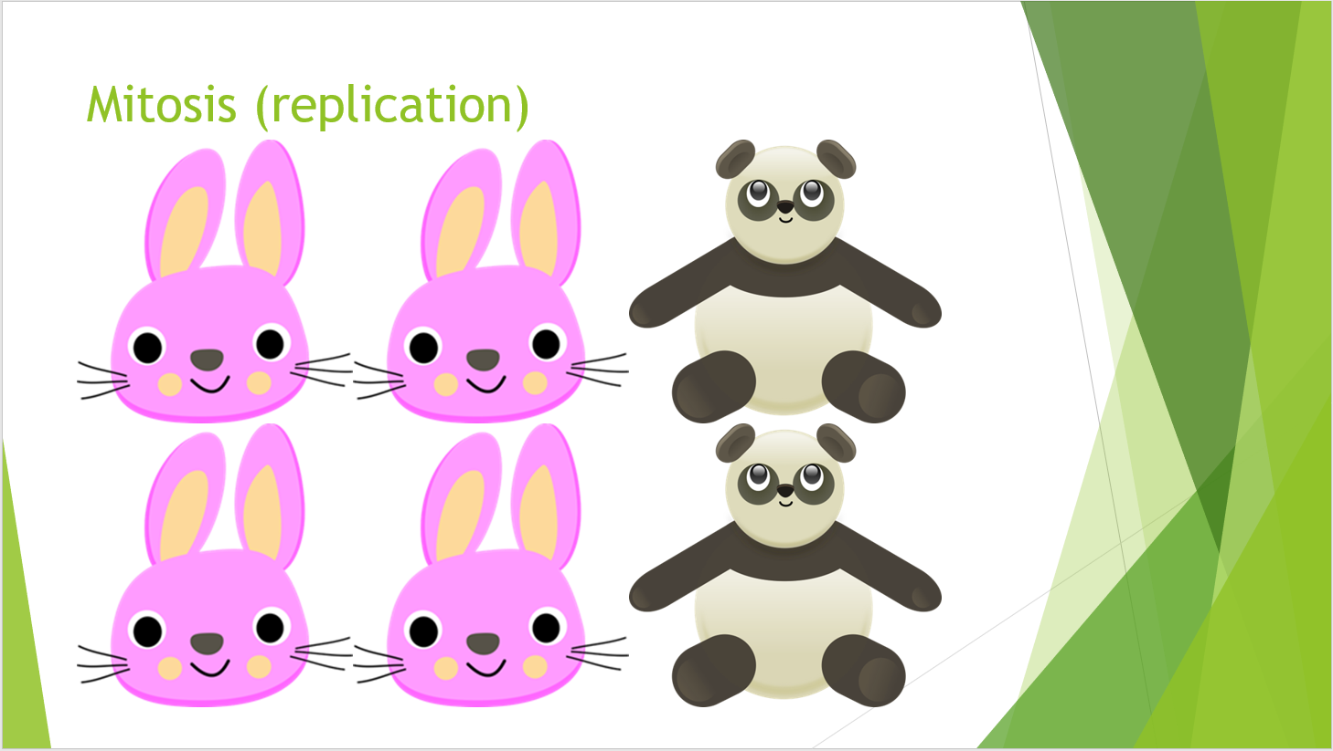
Thank you
Any questions?

